Slide 1
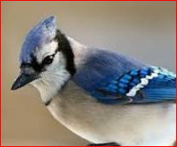
Welcome to UTM Team J Project presentation
Team Members
Raghavendra Samaga (Raghu)
Joonho Ye
Wilfred Valencia(Wil)

Slide 2

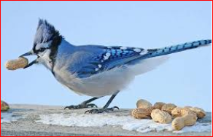
Defining scope
Select data source
World Health Organization
https://data.worldbank.org
https://en.wikipedia.org/wiki/List_of_countries_by_past_and_projected_GDP_(nominal)
Identify critical features
Treating Missing values
population

Slide 3

Defining context for usage
1
Classification of data
2
Prediction of mortality
3
Trend Analysis/ Correlations

Slide 4
Defining target performance

Slide 5
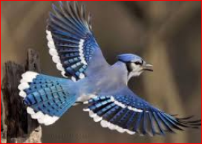
Defining the solution
Machine Learning Workflow
1
Process WHO data sheet
2
Transform data as required
Excel spreadsheets
Jupiter Notebook
numpy–scientific computing
pandas –data frames
matplotlib–2D plotting
scikit-learn
Algorithms
Pre-processing
Performance evaluation
And more …
3

Slide 6
Machine Learning Work flow
Preparing and tidying the data
General trend analysis
Selecting the algorithm to train the model
Testing the Model

Slide 8
Thank you!
Questions?

Slide 9

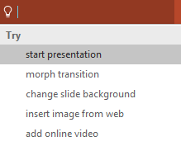

More questions about Project?
Select the Tell Me button and type what you want to know.
Visit the PowerPoint team blog
Go to free PowerPoint training
Give feedback about this tour
SELECT THE ARROW WHEN IN SLIDE SHOW MODE
Notes:
In Slide Show mode, select the arrows to visit links.

